Slide 1




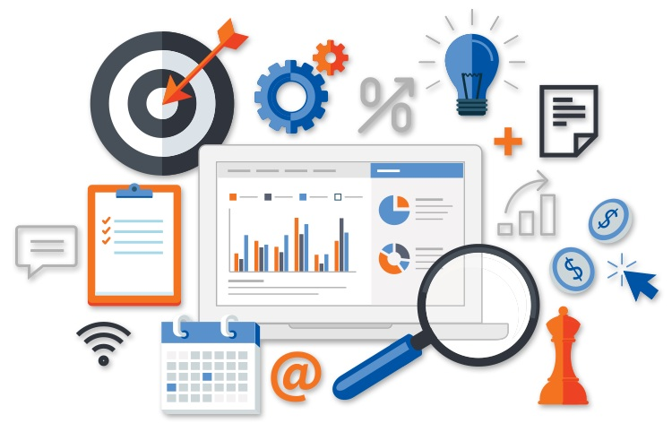
The Importance of Web Analytics for Friends of Disaster Relief (FDR)
Fred Wolfe
American Military University

Slide 2
Introduction: Understanding the Issue
  FDR’s website lacks web tracking and analytics tools for insight.
  Without tracking, we can't understand visitor behavior or engagement.
  The absence of analytics makes it hard to optimize donations.
  Implementing web analytics tools will improve donation process performance.
  Analytics will help make data-driven decisions for better results.
Notes:
Hello, everyone. Following my appointment as a Web Analyst for Friends of Disaster Relief, I was assigned one pressing concern: after having a well-put-up website, the organization may receive different donations. Through my observation of the site's current state, I see that its problem is its poor web tracking and analytics tools. These tools are necessary for tracking visitor behavior, measuring engagement, or determining at which stage the donation process fails. Today, I stand before you to explain why this is a critical problem and how we can resolve it by implementing web analytics tools that drive better results for FDR.

Slide 3

Why Web Analytics Matter
  Web analytics track and analyze user interactions on the website.
  Insights identify why visitors aren't donating and highlight improvement areas.
  Analytics show how visitors arrive, browse, and engage on site (Jansen, 2022).
  Data helps optimize user experience, increase engagement, and boost donations.
  Informed decisions allow adjustments to improve donation process and conversions.
www.pinterest.com
Notes:
Let’s start with the basics. Web analytics are tools and processes used to track and measure the interactions of users on websites. Generally speaking, the whole purpose behind web analytics is understanding how users behave and identifying why people are not completing donations, which will only happen with this part of the process. Without data, our only option is speculation as to where visitors are failing in attempting to donate. In such a case, web analytics can help us gain specific insights into key areas: visitor arrival at the site, what they do on it in browsing, where they drop off during the donation process, and how many finish with a donation(Jansen, 2022). With such insights, we can make informed, data-driven decisions that optimize the user experience to increase engagement and, ultimately, increase donation rates. Through analyzing these trends from this data, we can determine the areas to improve on the website to serve better for prospective donors.

Slide 4
The Consequences of Not Using Web Analytics
  Without web analytics, we lack understanding of visitor behavior.
  No tracking means missing insights into page visits and engagement.
  Conversion tracking is necessary to measure donations and identify barriers.
  Without data, we can't assess marketing campaign effectiveness or impact.
  Absence of analytics prevents optimization of website and marketing strategies.
Notes:
With web analytics, we are in a high-risk position where we would be operating with an idea of what is going on with visitors to the site. With the ability to track visitor behavior, we will know which pages are being visited, how long users stay, and what actions they take afterward. This leaves us wondering whether they engage with the content or leave the page quickly. Moreover, without tracking conversions, we will be blind to how many visitors make donations and which pages drive the most donations. Therefore, we cannot analyze what part of the donation-making process potential donors drop out. We will need to find out which programs, social media ads, or emails effectively drive traffic-generating donations. This requires more data, meaning the website's optimization or refinement in marketing strategies is impossible, which misses opportunities to enhance the user experience and increase donation rates.

Slide 5
What Should We Be Tracking?
  Track visitor demographics to tailor content and campaigns effectively.
  Monitor traffic sources to understand where visitors are arriving from.
  Track pages visited and time spent to identify engagement areas.
  Measure conversion rates to understand donation completion and process issues.
  Identify exit pages to pinpoint issues causing visitor abandonment.
Notes:
Several metrics have to be accordingly tracked to understand the exact problem. First, knowing the demographic type based on age, sex, location, and device used helps create content for an ideal target audience. Second is the source of the traffic to identify where it originates from, whether searches in Google, social media, or links directly. Thirdly, monitoring the pages visitors go through and how much time they spend on each will flag off areas that may have to be changed in content or design. Fourthly, conversion rates show what number of visitors out of them donate, thus allowing knowing any potential problems with a donation process. Knowing the exit pages on which visitors leave the site will help zero in on any problem areas, especially on the donation page.

Slide 6

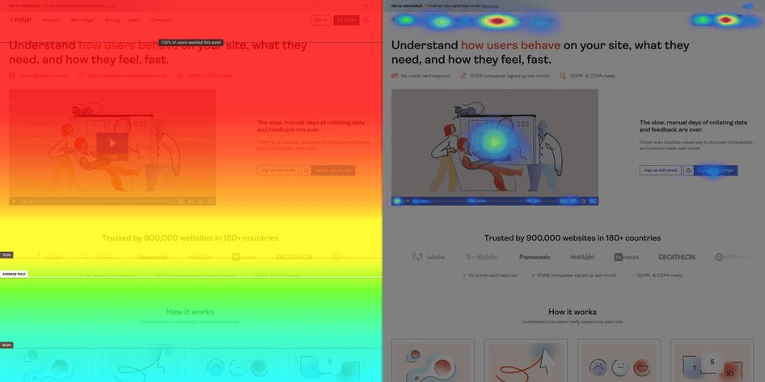

The Right Tools for Web Analytics
  Google Analytics provides insights into traffic, behavior, and conversions (Shaheen, 2023).
  Hotjar offers heatmaps and session recordings to visualize user behavior.
  Facebook Pixel tracks visitor behavior from Facebook ads and donations (Bekos et al., 2023).
  Donation tracking platforms monitor transactions and track key donation metrics.
  Use specialized tools to understand donation size, frequency, and retention.
Notes:
Some of the various tools we can use to collect and analyze web data include Google Analytics. This industry-leading tool will give us an overview of the traffic on our website, how users behave, and the rate at which conversions are made (Shaheen, 2023). Hotjar is very good at heatmap and session recordings, which visually show us where people click, scroll, and hover to gather more detailed insight about how it works regarding site visitors and the donors' landing page. With the running of paid ads through Facebook, Pixel will help track how visitors from our ads interact with the website and whether or not a donation is eventually made (Bekos et al., 2023). Besides, the donation tracking platform is a unique tool that can be integrated into various payment gateways to trace a donation transaction using essential parameters such as size, frequency, regularity of donation, loyalty of donors, and more.

Slide 7


Implementing Web Analytics
  Add tracking codes to key pages like homepage, landing, donation.
  Link Google Analytics with Hotjar and Facebook Pixel for insights.
  Set up conversion goals in Google Analytics to track donations.
  Implement event tracking for specific user actions, like button clicks.
  Capture detailed user behavior to improve site effectiveness and conversions.
Notes:
Once the appropriate tools have been selected, the next step will be implementation on the website to collect data. It involves adding tracking codes to critical pages like the homepage, landing page, and donation page, ensuring that every critical user interaction is tracked. Once Google Analytics is integrated, we will connect it with Hotjar and Facebook Pixel to enable tracking user behaviors across multiple platforms. The ability to track specific actions, such as the completion of a donation, will come from setting up goals in Google Analytics for conversions, showing how well the site converts visitors into donors. It will also help track events that capture specific user actions, such as clicking the "Donate Now" button or interacting with the donation form. This would be important in garnering comprehensive insights into the users' behaviors.

Slide 8
Turning Data into Actionable Insights
  Analyze traffic sources to identify high-converting marketing channels.
  Refine social media ads or landing pages for better results.
  Investigate user behavior to improve areas causing visitor drop-offs.
  Optimize donation page layout, load time, or payment process.
  Use demographic data to target high-converting age groups or locations.
Notes:
Data collection stops being important when analyses are done with such data; from this, some meaningful insights into action could be derived. AnalyzingYou can identify which marketing channels drive the most visitors and provide the highest conversion rates by analyzing traffic sources. For example, if the social media ads are moving but not converting, we can optimize the ad targeting or change something on the landing page. We will also be able to determine at what points users drop off or fail to complete their donations by analyzing user behavior on the site. We can investigate the page layout, load time, or the payment process for possible problems if many people leave the donation page. Lastly, demographic data will help us in adjusting our marketing strategies. If particular age groups or locations are more likely to donate, we can better tailor future campaigns to target these segments.

Slide 9
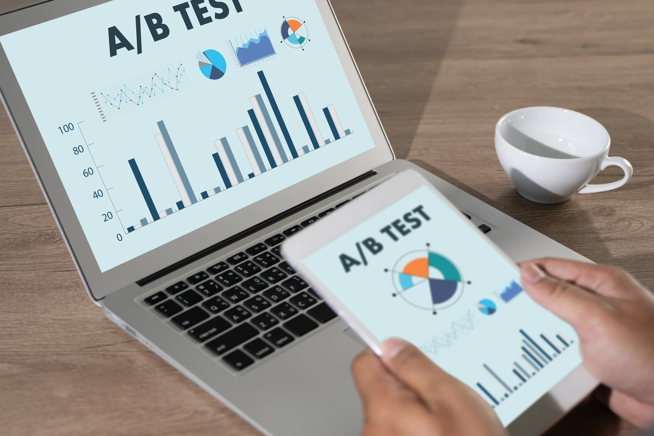
Optimizing the Donation Process
  Conduct A/B testing to find best donation page design.
  Test different donation form lengths and call-to-action placements.
  Simplify the donation process to reduce abandonment rates.
  Make the donation process user-friendly and easy to navigate.
  Offer incentives like thank-you notes or exclusive content.
www.marketingevolution.com
Notes:
Once we have gathered the data, the next step is to optimize the donation process. One approach we can take is A/B testing: we experiment with different versions of the donation page to determine which design or layout increases conversions. For instance, we can A/B test a shorter versus longer donation form or show different placements of the call-to-action button to find out which one works the best. Also, remember the shorter and more comfortable the donation process is, the more effective it will be. People avoid being entangled with some long, complicated procedure; we are to make it easy, user-friendly. Another motivational strategy to donate includes all kinds of motivators for a giver, like a thank-you note or a badge or some special content only available for them.

Slide 10
Conclusion: Why Analytics are Essential for FDR
  Web analytics enhance visitor behavior tracking and engagement strategies.
  Analyzing traffic sources helps refine marketing effectiveness and conversions.
  Web analytics empower informed decisions to improve user experience.
  Optimizing digital efforts ensures the website supports FDR’s mission.
  Implementing web analytics maximizes donations and advances FDR’s cause.
Notes:
Therefore, Web analytics is the key to success for FDR. The monitoring of visitor behavior, studying sources of traffic, and refining the donation process all contribute to enhanced donor engagement and higher conversion rates. In turn, these will help FDR make decisions about user experience and enhanced marketing effectiveness. Web analytics allows optimizing digital efforts by making sure that the website effectively serves the mission of FDR. Such tools are in high demand for the pursuit of better donations and a stand for FDR's cause.
Thank you for your time. I'd be happy to answer any questions you may have.

Slide 11
References
  Bekos, P., Papadopoulos, P., Markatos, E. P., & Kourtellis, N. (2023). The Hitchhiker’s Guide to Facebook Web Tracking with Invisible Pixels and Click IDs. ArXiv (Cornell University). https://doi.org/10.1145/3543507.3583311
  Jansen, B. J. (2022). Understanding user-web interactions via web analytics. Springer Nature (29-33).
  Shaheen, A. (2023). Maximizing Website Performance with Google Analytics. Türk Bilgisayar ve Matematik Eğitimi Dergisi, 14(03), 1273–1277. https://doi.org/10.61841/turcomat.v14i03.14229

